Slide 1
Strength of Weak Ties

Slide 2
Core elements of the theory
Acquaintances less like to be connected to one another that close friends
In graph theoretic terms:
  The subgraph of ego’s neighbors who are strongly tied to ego has high density
  The subgraph of ego’s neighbors who are weakly tied to ego has low density

Slide 3
Core elements of the theory
Weak ties therefore function as bridges to parts of social structure to which ego wouldn’t otherwise have access
This implies that:
  Absent weak ties will not have access to distant parts of the social system
    Information will tend to be local
  Lack of weak ties may put ego at a disadvantage when novel information is valuable

Slide 4
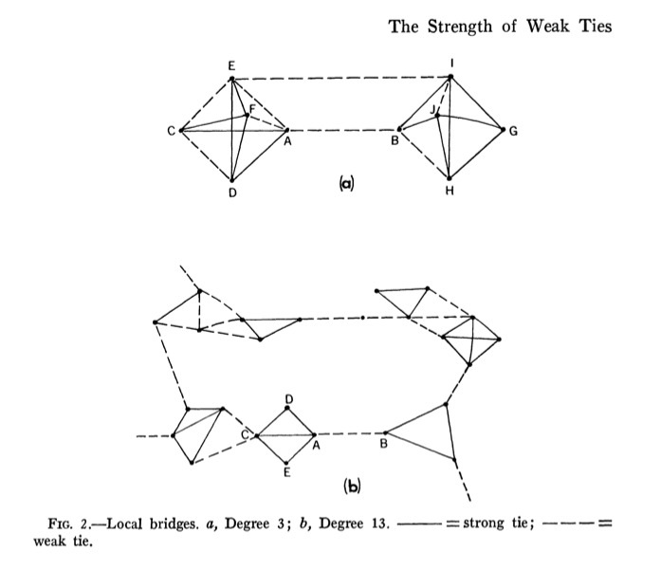
Core elements of the theory
At the level of the social system absence of weak ties implies:
  Fragmentation into disconnected communities characterized by strong tie clusters
  Diffusion of new ideas in such a system would be difficult
    Innovations remain trapped in local clusters
  Collective action and global coordination would be difficult
    Social divisions will be salient

Slide 5
Core elements of the theory
Classical sociological theory presumed that weak ties bred alienation and disconnection from others
The weak tie argument suggests that weak ties actually integrate people into wider social structures
  Strong ties connect you similar others
  Weak ties connect you to different others
    Interacting with different others forces you to be flexible

Slide 6
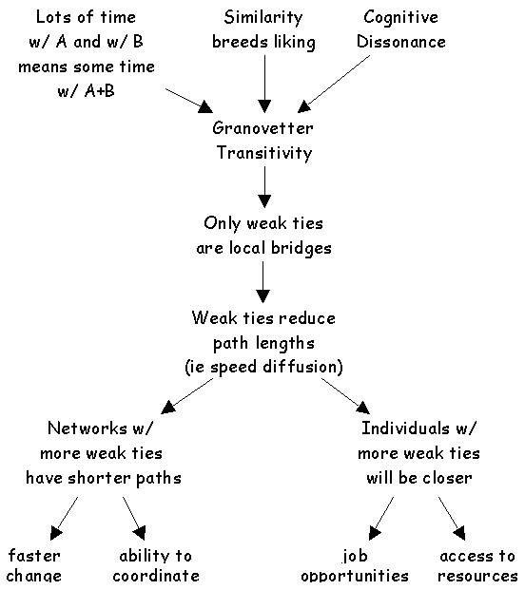
Application: Getting a job
If social mobility (e.g. finding new job opportunities) depends on (new) information access:
  Then having weak ties will be correlated with mobility and other forms of success
  Contacts with whom you are weakly connected will be more likely to know something you don’t know
  Weak ties help you insofar as they connect you to others with access to both information and resources

Slide 7
How do you measure tie strength?
Multiple indicators have been suggested as (jointly?) making up the concept of tie strength
  Time spent together
  Relationship duration
  Emotional intensity
  Reciprocal exchanges
  Intimacy and confiding
Which ones are the best indicators?
  MIxes together frequency, sentiment, and exchange criteria
    “The strength of a tie is a (probably linear) combination of the amount of time, the emotional intensity, the intimacy (mutual confiding) and the reciprocal services which characterize the tie” (Granovetter 1973: 1361)

Slide 8
How do you measure tie strength?
Problems with previous approaches:
  Some mix together role-relation and sentiment criteria
    E.g. “Close Friends”
  Some (even worse) use role-relations criteria to define tie strength
    E.g. Kin and Friends are strong ties, acquaintances, co-workers, and neighbors are weak ties
      Problem: You can be weakly connected some relatives and strongly connected to some co-workers
  Others use purely frequency based criteria
    Problem: You can be weakly connected to people you see frequently
  Others use the number of kinds of relations connecting people
    “Multiplex” ties are strong
      But some multiplex relations can be weak

Slide 9
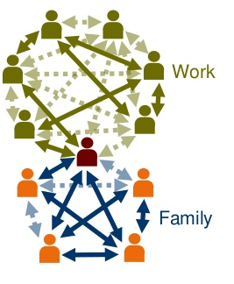
How do you measure tie strength?
Other approaches:
  Duration of the relationship?
  Provision and exchange of services and support?
  Socio-demographic similarity?
  Overlap in common memberships?
But we can imagine the weak/strong dimension cross-cutting all of these factors
  Need to compare multiple indicators against suitable criteria

Slide 10
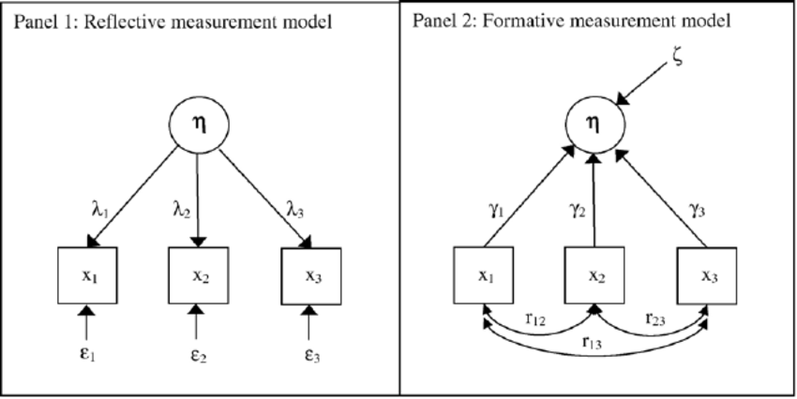
How do you measure tie strength?
One approach:
  Distinguish between indicators of tie strength and predictors of tie strength
Indicators:
  Closeness/Intimacy
  Frequency of Interaction
  Duration
  Exchange/Support/Discussion
Predictors:
  Role relations (Friend, Co-worker)
  Common memberships/Foci
  Social similarity

Slide 11
How do you measure tie strength?
One approach:
  Distinguish between indicators of tie strength and predictors of tie strength
From classic Marsden and Campbell Study:
  Subjective closeness most reliable indicator
  Frequency is confounded with other aspects
    E.g. you see weak ties (neighbors, coworkers frequently)
    E.g. You don’t see long running contacts frequently
  Don’t want to use predictors as proxies

Slide 12
How do you measure tie strength?
One approach:
  Distinguish between indicators of tie strength and predictors of tie strength
From classic Marsden and Campbell Study:
  May want to use multiple measures of intensity
  Confiding and exchange indicators not necessarily a measure of strength
    Consistent with Small (2013)
  Duration and frequency are confounded by role-relations and foci

Slide 13
How do you measure tie strength?
Outstanding issues:
  Is tie strength a unidimensional or multidimensional construct?
  Do we need to pay attention to the temporal or sequential evolution of tie-strength?
  Is reciprocity (matching in the strength of directed ties) an inherent component of strength?
  Can ties be strong but “dormant”?
  Is “robustness” (e.g. resistance to change or decay) an inherent component of strength?
  Are “behavioral” measures capable of capturing the strength concept?

Slide 14
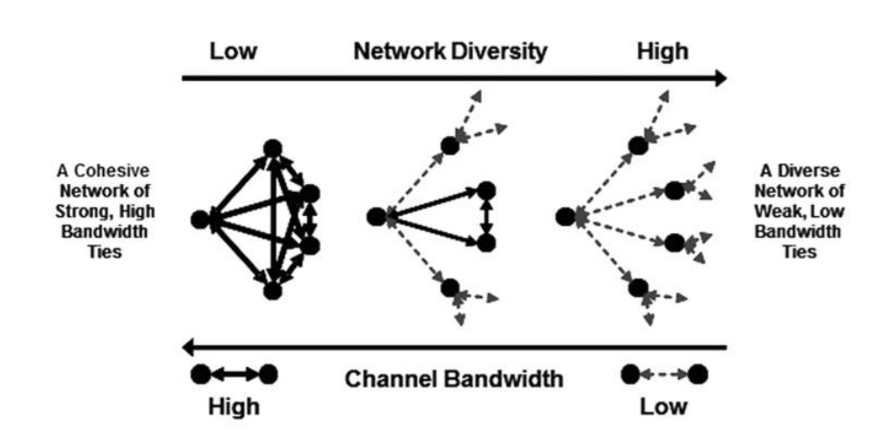
Diversity-bandwidth tradeoff
Original Granovetter argument conceives of the properties of ties (e.g. strength) in largely static terms
  Yet information transmission/access are events that happen in time
In original SWT argument:
  Weak ties: Novel information
  Strong ties: Old/redundant information

Slide 15
Diversity-bandwidth tradeoff
When taking into account temporal flow:
  “Weak” ties: Information transmission at slower rates (less frequency)
  “Strong” ties: Information transmission at higher rates (more frequency)
When seeking information via social networks
  There is a tradeoff between novelty/diversity of information and tie “bandwidth”

Slide 16
Diversity-bandwidth tradeoff
What about information complexity?
  Low bandwidth ties: Novel but “simple” information
    E.g. job availability
  But what about novel but complex information?
    E.g. How to do network analysis in Python
  In that case higher bandwidth ties are better

Slide 17
Diversity-bandwidth tradeoff
The strength of high bandwidth ties:
  More trust, intimacy, and cooperativeness
  Better memory of who knows what
  More effective at transferring complex, interdependent information
  Creating new knowledge (e.g. bringing together rather than keeping apart)
  Commonality of interests and experience (homophily)

Slide 18
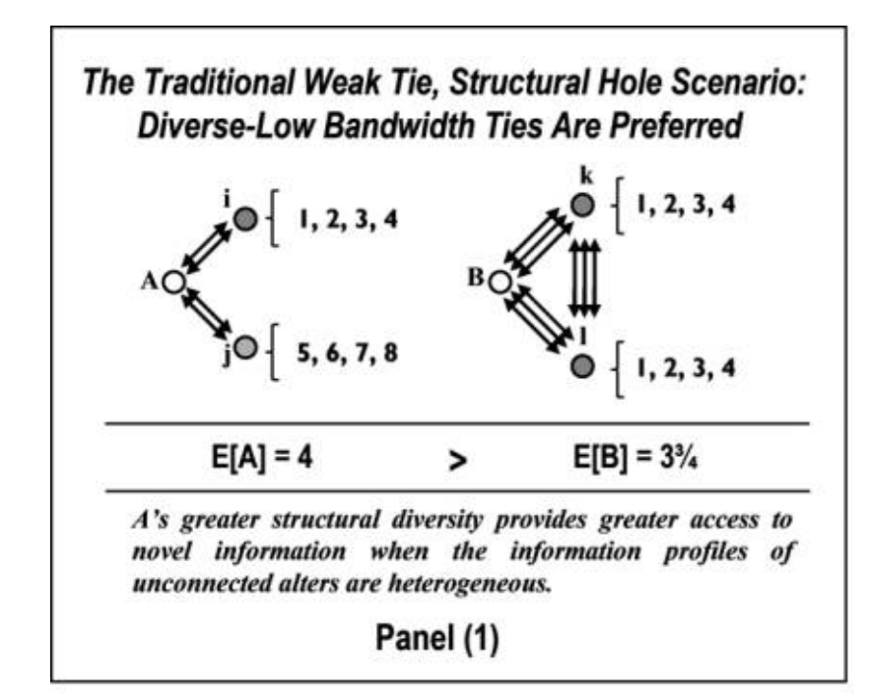
Diversity-bandwidth tradeoff
In thinking about preferences between low and high bandwidth ties we must take into account properties of the information environment
  Who knows what?
  At what frequency is knowledge transmitted?
Low bandwidth works better when contacts are diverse in information

Slide 19
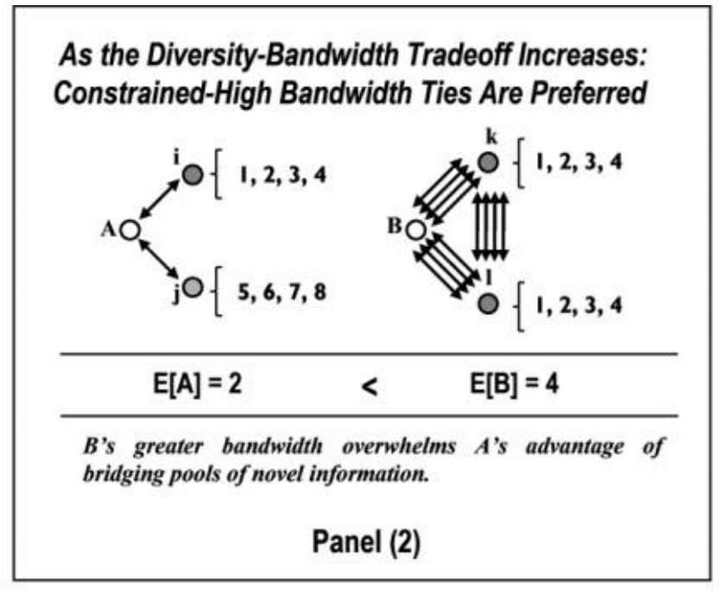
Diversity-bandwidth tradeoff
In thinking about preferences between low and high bandwidth ties we must take into account properties of the information environment
  Who knows what?
  At what frequency is knowledge transmitted?
Low bandwidth works better when contacts are diverse in information
  However very low bandwidth ties lose their advantage even when connecting ego to informationally diverse contacts

Slide 20
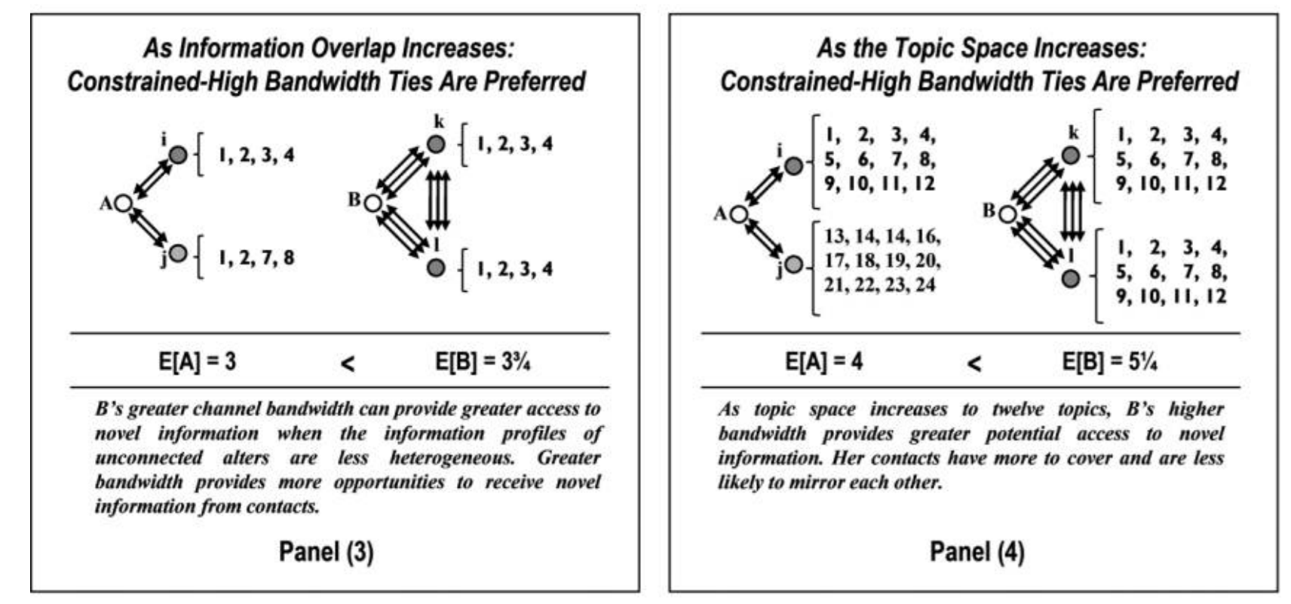
Diversity-bandwidth tradeoff
Advantage of low bandwidth ties is also compromised when:
  There is even minimal overlap in information across contacts
  The information environment is richer and more complex
  When who knows what changes rapidly over time
Low bandwidth ties are only preferable when:
  Information is relatively static and there is high diversity in who knows what

Slide 21
Diversity-bandwidth tradeoff
Advantage of low bandwidth ties is also compromised when:
  There is even minimal overlap in information across contacts
  The information environment is richer and more complex
  When who knows what changes rapidly over time
Low bandwidth ties are only preferable when:
  Information is relatively static and there is high diversity in who knows what

Slide 22
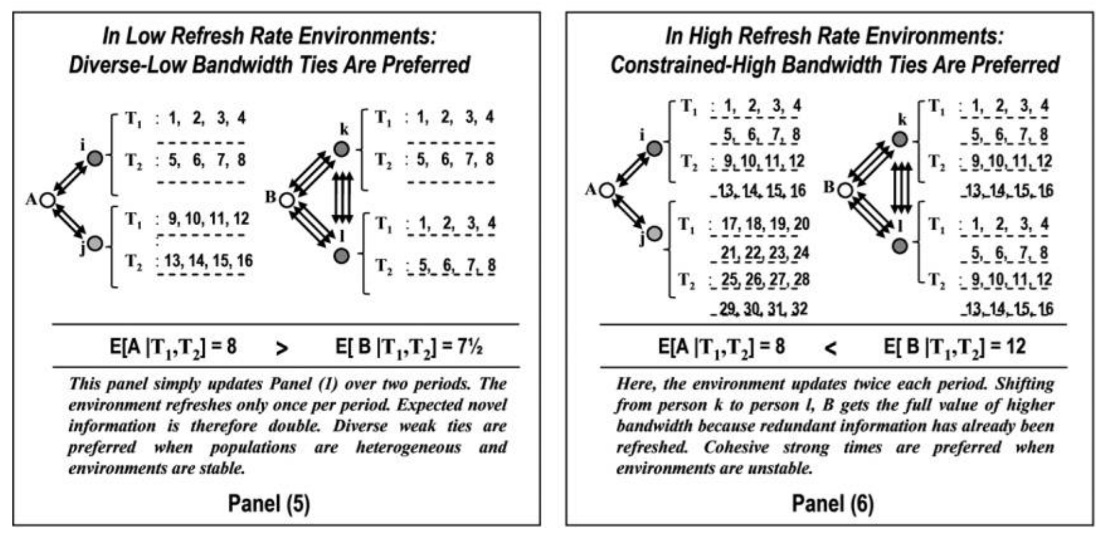
Diversity-bandwidth tradeoff
Advantage of low bandwidth ties is also compromised when:
  There is even minimal overlap in information across contacts
  The information environment is richer and more complex
  When who knows what changes rapidly over time
Low bandwidth ties are only preferable when:
  Information is relatively static and there is high diversity in who knows what

Slide 23
Diversity-bandwidth tradeoff
Advantage of low bandwidth ties is also compromised when:
  There is even minimal overlap in information across contacts
  The information environment is richer and more complex
  When who knows what changes rapidly over time
Low bandwidth ties are only preferable when:
  Information is relatively static and there is high diversity in who knows what

Slide 24
Diversity-bandwidth tradeoff
Bandwidth tradeoff propositions (revision of SWT theory):
  Channel bandwidth is positively associated with receiving more diverse information and more total non redundant information
  The greater the information overlap among alters, the less valuable structural diversity will be in providing access to novel information
  The broader the topic space, the more valuable channel bandwidth will be in providing access to novel information.
  The higher the refresh rate, the more valuable channel bandwidth will be in providing access to novel information.

